Slide 1
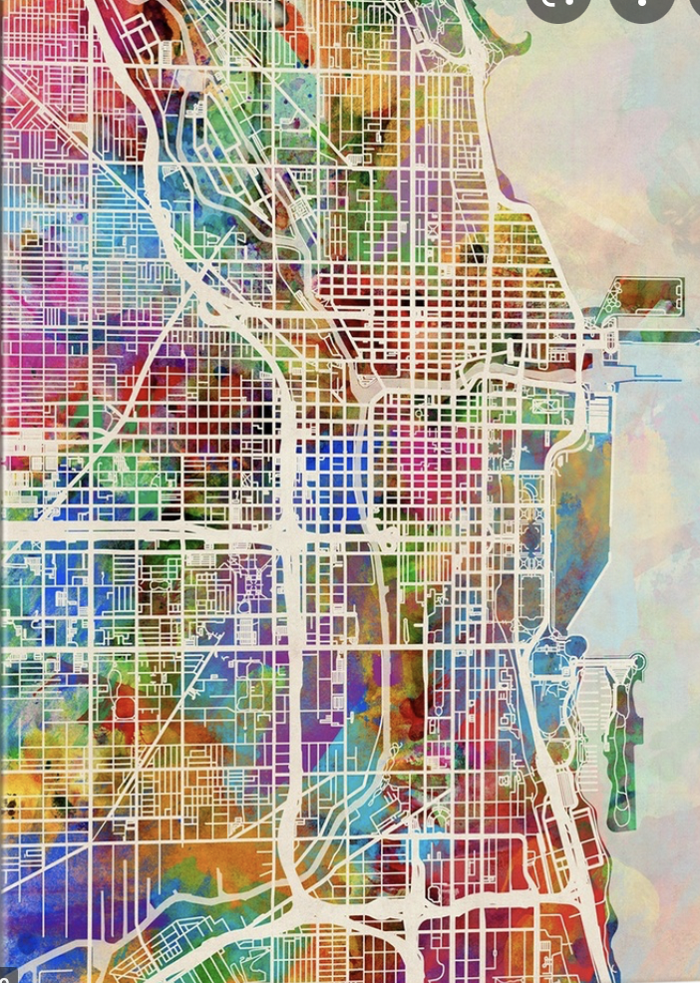

Location to open business – Clustering problem
Avishek Roy

Slide 2
Data Problem – Suitable location to open a business (Gymnasium)
A Business Owner wants to find a suitable location in Chicago Area to open a new Gym. As a business perspective it is very important to know your competition. If we know already how many gymnasium are present in that area and also how many population , it might give us good insight about preferable area to open a gymnasium. A Data Science analysis by doing cluster of different locations by zip code for number of existing gym and population would be beneficial to reach final decision about new location.

Slide 3
Method – Clustering
Clustering or cluster analysis is an unsupervised learning problem. It is often used as a data analysis technique for discovering interesting patterns in data, such as groups of customers based on their behavior. It involves automatically discovering natural grouping in data. Unlike supervised learning (like predictive modeling), clustering algorithms only interpret the input data and find natural groups or clusters in feature space.
A cluster is often an area of density in the feature space where examples from the domain (observations or rows of data) are closer to the cluster than other clusters. The cluster may have a center (the centroid) that is a sample or a point feature space and may have a boundary or extent.
There are many clustering algorithms to choose from and no single best clustering algorithm for all cases. Instead, it is a good idea to explore a range of clustering algorithms and different configurations for each algorithm.

Slide 4
Algorithm – K Means
K-means clustering is one of the simplest and popular unsupervised machine learning algorithms. ... In other words, the K-means algorithm identifies k number of centroids, and then allocates every data point to the nearest cluster, while keeping the centroids as small as possible.
To process the learning data, the K-means algorithm in data mining starts with a first group of randomly selected centroids, which are used as the beginning points for every cluster, and then performs iterative (repetitive) calculations to optimize the positions of the centroids
It halts creating and optimizing clusters when either. The centroids have stabilized — there is no change in their values because the clustering has been successful. The defined number of iterations has been achieved.

Slide 5
Data Sources
The data is from the US Census. Below are 1,382 Illinois zip codes ranked 1 through 1,258. Some of these zips may be mostly within a neighboring state and only slightly within Illinois. We follow the US Census Bureau’s lead here and if any portion of the zip code intersects Illinois (no matter how small), we include that zip code both in the Illinois list below as well as in the neighboring state’s list of zip codes.
Finding out centroid of each zip code latitude, longitude
https://simplemaps.com/data/us-zips
Calling Foursquare API to get all The Gym counts around each post code
https://api.foursquare.com/v2/venues/search

Slide 6
Steps
All the postcodes of Chicago with neighborhood and city name were collected from data source . Then list is appended with corresponding latitude and longitude co-ordinate values. Foursquare API has been called for each latitude and longitude to find count of all facilities categorized as gym within 1 mile radius. Also population data by post codes is collected from US Census. In Next step, scatter plot was done for each data points (postcodes) using population and count of gym as X and Y co-ordinates.
Unsupervised Machine learning algorithm K-Means was applied on that data and all the postcodes are segmented in 5 cluster. Scatter plot was drawn to show them by color code. For last step, All the post code areas are projected on Chicago map by showing each area by color code to help business owner to take decision on ideal location.

Slide 7
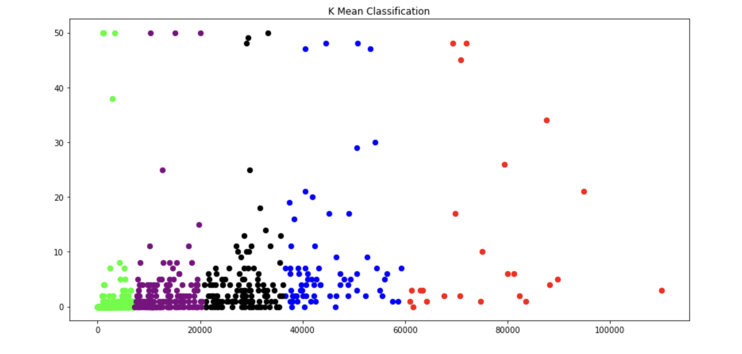
Clustering Result
Clustering result is shown in the right-hand side
All the Chicago area zip code areas are marked with color code for different segment identified by K-means algorithm. It will help to take decision for new gym location.

Slide 8
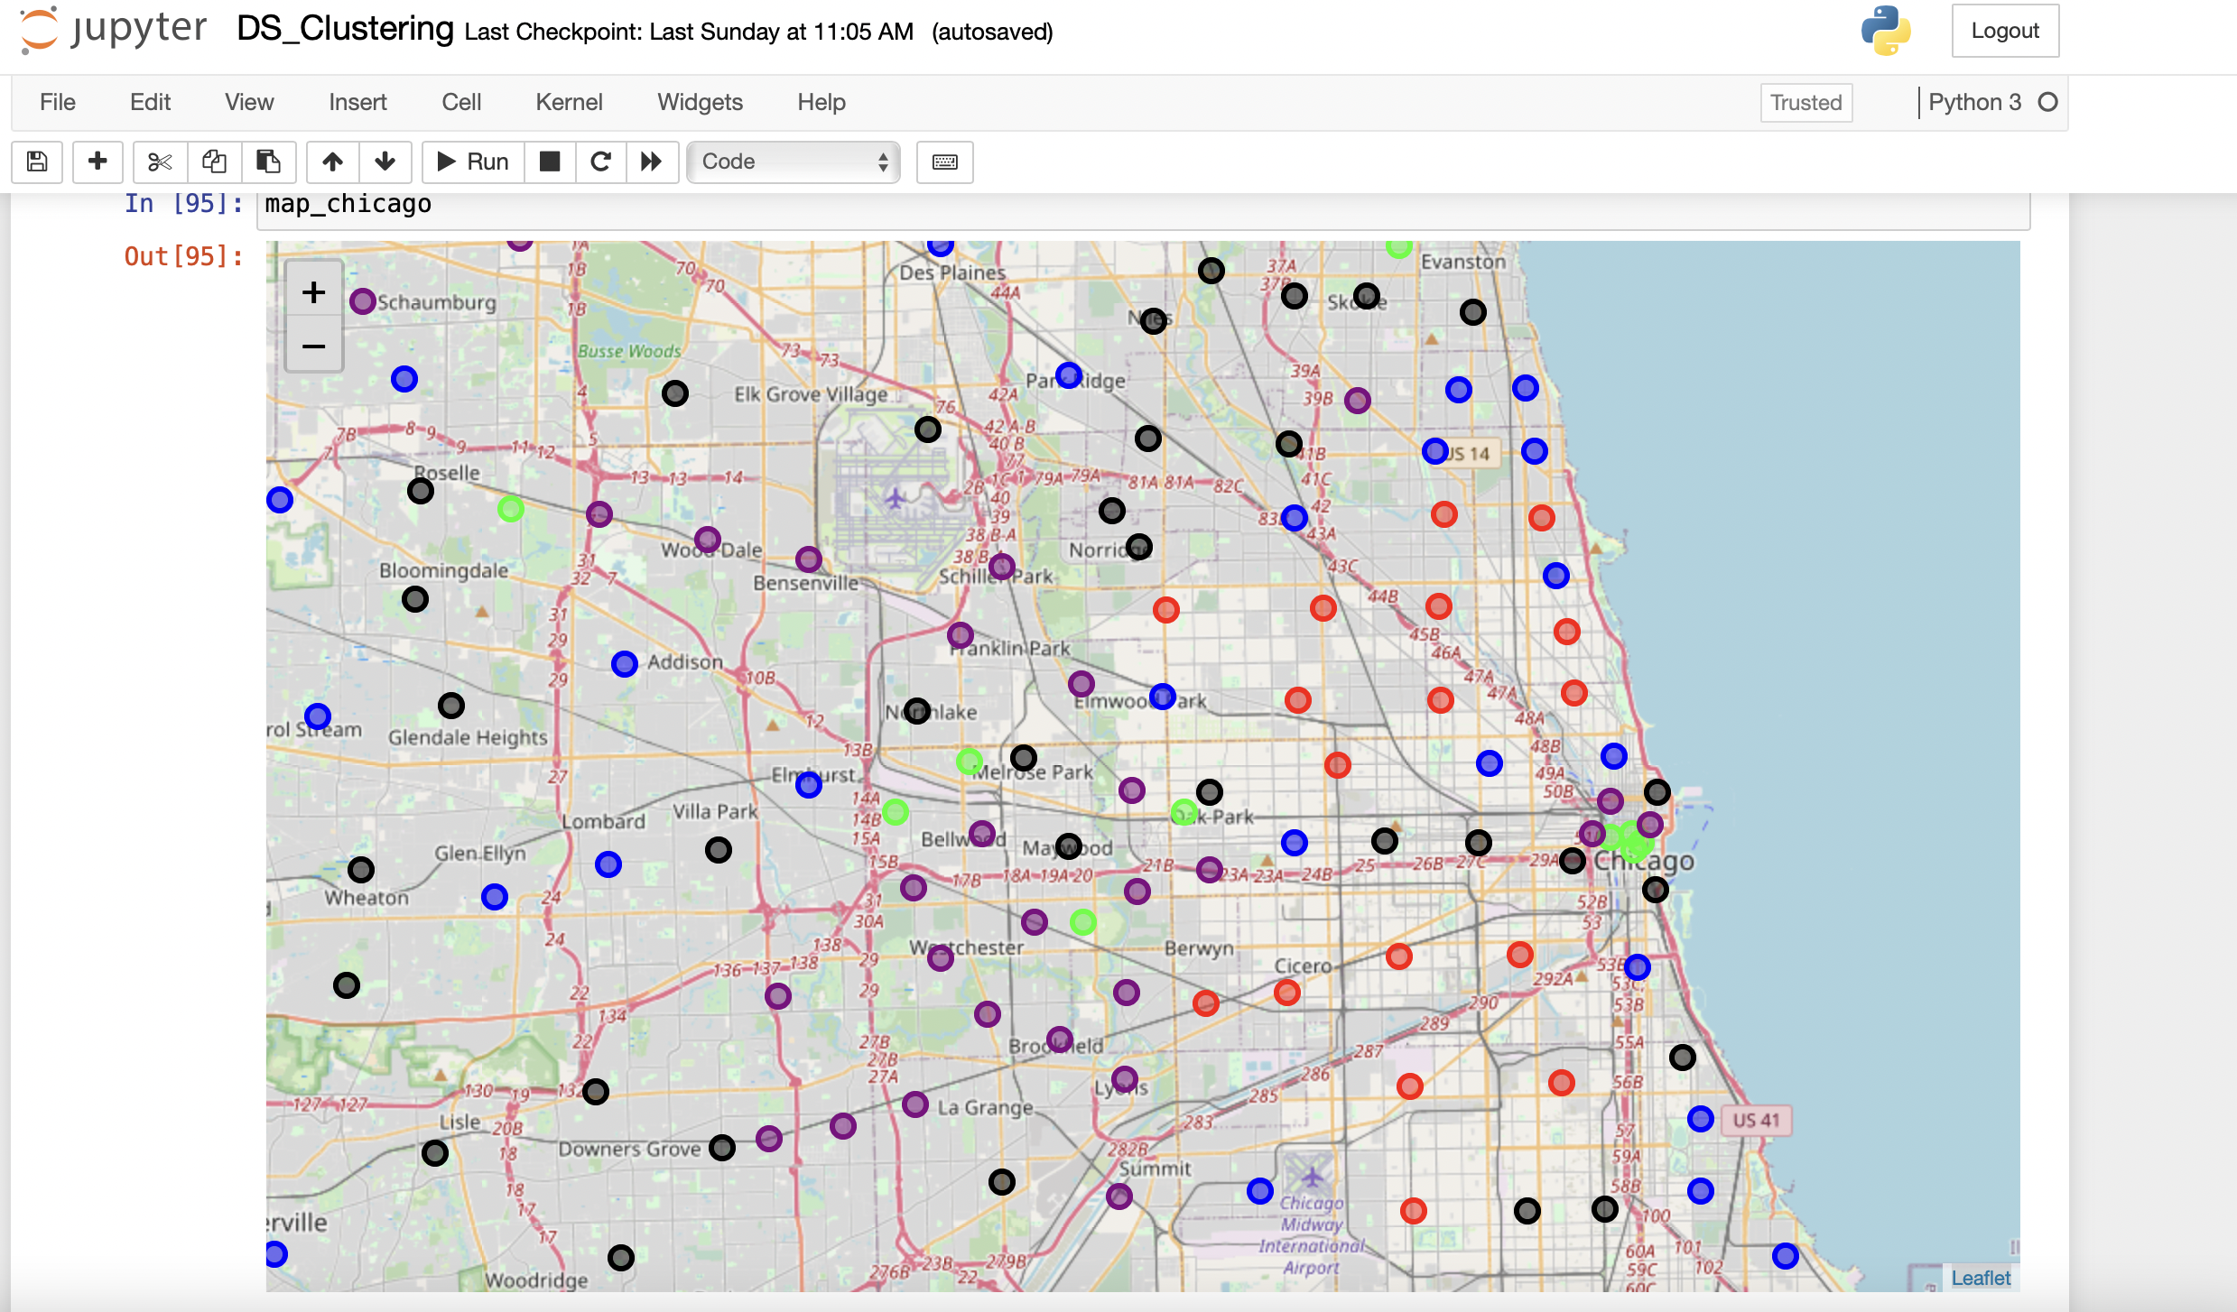
Map
Clusters projected on Map

Slide 9
Conclusion and Recommendation
In the plot , we can see all the points are clustered for 5 category. Red areas are high population , but also few average gymnasium numbers. On the other hand, Yellow points, where gym are low in number , but also population is also low. In this dataset , Blue points are where population and number of gymnasium are moderate.
It seems Blue areas are the best fit for new areas for gymnasium, because it is better than Red where already more gymnasiums are present and Yellow areas are population is less.
Those zip codes are plotted in the map to identify exact area. This analysis could be scalable by adding other different parameters into considering. This way more scientific and informative decision could be made which will finally lead business success.

Slide 10
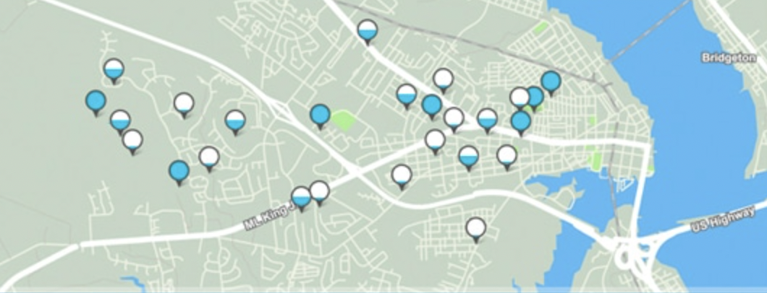
Thank you
For any question or comments – please reach out to avroy@my365.Bellevue.edu

